Slide 1
Network Basics
Last update: March, 2021
Engr. Md. Abdur Rashid
Director (A & F)
NAPD
https://www.researchgate.net/profile/Md-Abdur-Rashid
PGDICT4D, 11 Batch

Slide 2
Today’s Objectives
Data Communication
Network Topology
Backbone Network
Visit NAPD Network Backbone
PGDICT4D, 11 Batch

Slide 3
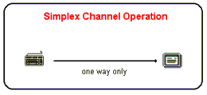
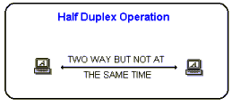
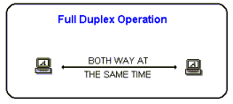
Data Communication Channels
The following is a discussion on the THREE main types of transmission circuits (channels), simplex, half duplex and full duplex.
Simplex
  Data in a simplex channel is always one way. Simplex channels are not often used because it is not possible to send back error or control signals to the transmit end.
  Half Duplex
    A half duplex channel can send and receive, but not at the same time. Its like a one-lane bridge where two way traffic must give way in order to cross. Only one end transmits at a time, the other end receives.
Full Duplex
  Data can travel in both directions simultaneously. There is no need to switch from transmit to receive mode like in half duplex. Its like a two lane bridge on a two-lane highway.
PGDICT4D, 11 Batch

Slide 4
Data Communication Channels, Examples
Examples are-
Simplex
  doorbell the signal can go only from the button to the chime.
  television broadcasting
  radio broadcasting
Half-Duplex
  walkie-talkie
  Often the line between a desktop workstation and a remote CPU conforms to the half duplex patterns
Full-Duplex
  A Telephone
  mainframe-to-mainframe (Many hardware communication)
PGDICT4D, 11 Batch

Slide 5
Network
A group of computers and associated peripherals connected by a communications channel capable of sharing files and others resources between several users.
PGDICT4D, 11 Batch

Slide 6
What does the network do
By using the network the user will be able to work as a team with other staffs and obtain access to a whole range of facilities and information.
By using a network it is possible to save a great deal of time because all users can look in the same place for the same time.
PGDICT4D, 11 Batch

Slide 7
Uses of Network
Sharing files
Sharing printer (country network share possible)
Sharing Application Programs
E-mail
Remote Access
Common Access to Internet
Common Security System
Intranet
PGDICT4D, 11 Batch

Slide 8
Types of Network Relationships
Two types of relationships :
Peer-to-Peer Network
Server-Based Network (Client-Server)
PGDICT4D, 11 Batch

Slide 9
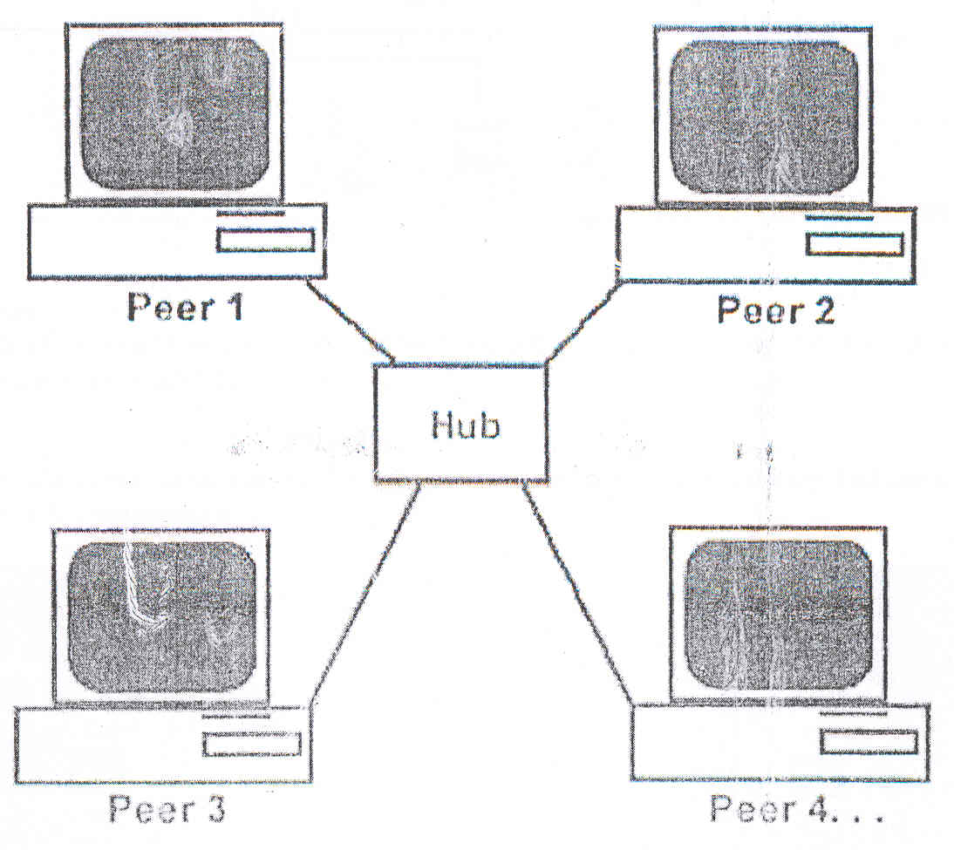
Peer-to-Peer Network – is one in which all computers on the network communicate with each other at equals. Each computer is responsible for making its resources available to others.
PGDICT4D, 11 Batch

Slide 10
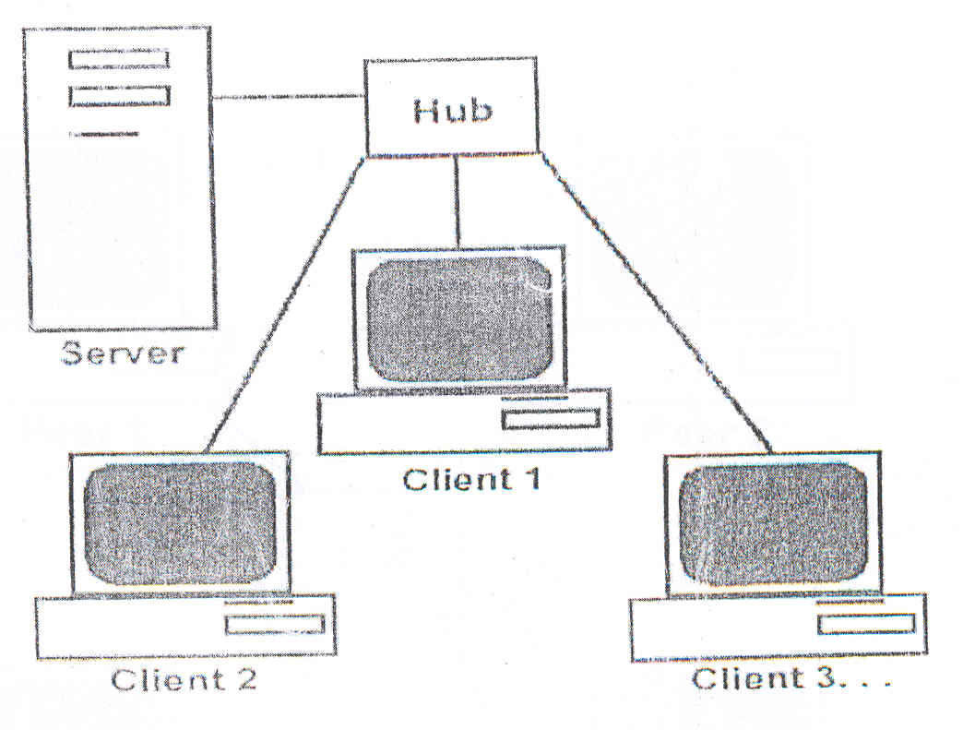
Server-Based Network (Client-Server) – is one in which a server makes resources available to other computers and the clients retrieve those resources from the server.
PGDICT4D, 11 Batch

Slide 11
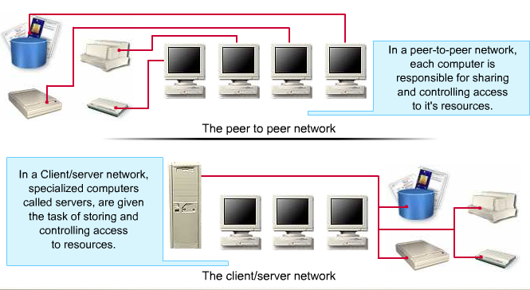
PGDICT4D, 11 Batch

Slide 12
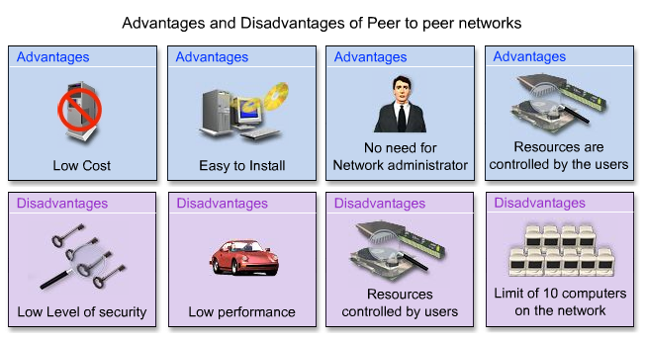
PGDICT4D, 11 Batch

Slide 13
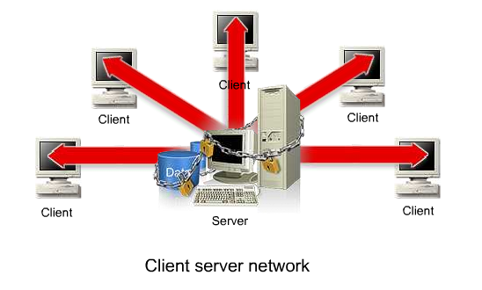
PGDICT4D, 11 Batch

Slide 14
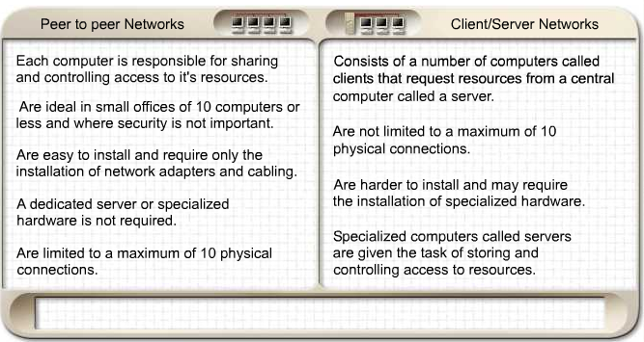
PGDICT4D, 11 Batch

Slide 15
Network Types
Three basic types of network systems :
Local Area Network (LAN) : within a small geographical area
Metropolitan Area Network (MAN) : within a metropolitan city
Wide Area Network (WAN) : geographically dispersed network, a collection of LANs such as internet
PGDICT4D, 11 Batch

Slide 16
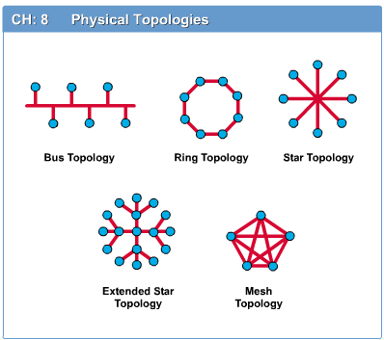

Network Topology
The network topology defines the way in which computers, printers, and other devices are connected. A network topology describes the layout of the wire and devices as well as the paths used by data transmissions.
PGDICT4D, 11 Batch

Slide 17
Bus
Single cable connects all network nodes without intervening connectivity devices
Devices share responsibility for getting data from one point to another
Terminators stop signals after reaching end of wire
  Prevent signal bounce
Inexpensive, not very scalable
Difficult to troubleshoot, not fault-tolerant
PGDICT4D, 11 Batch

Slide 18
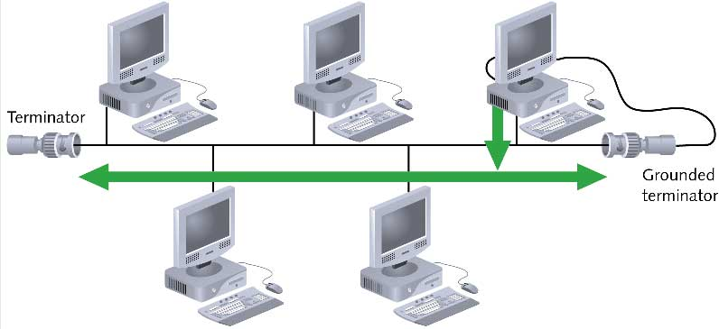
Bus (continued)
PGDICT4D, 11 Batch

Slide 19
Advantages of Bus Topology
Works well for small networks
Relatively inexpensive to implement
Easy to add to it
Disadvantage
Management costs can be high
Potential for congestion with network traffic
PGDICT4D, 11 Batch

Slide 20
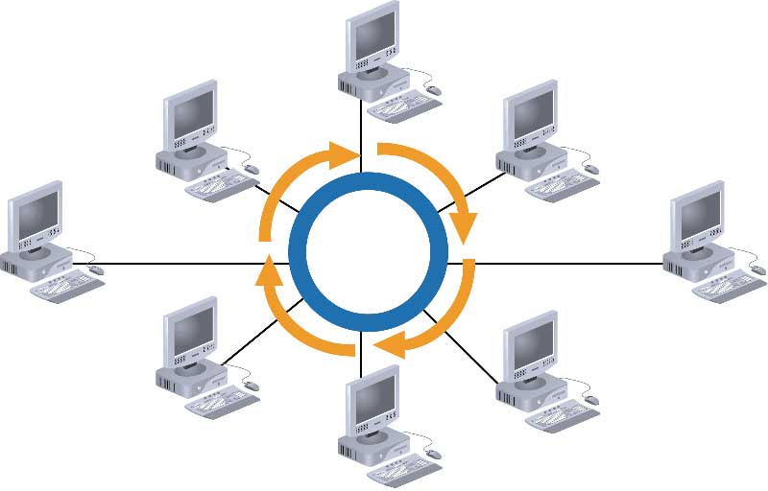
Ring
PGDICT4D, 11 Batch

Slide 21
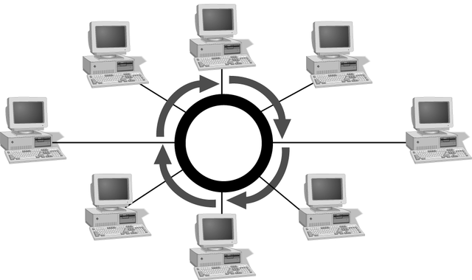
Simple Physical Topologies
Ring topology
  Each node is connected to the two nearest nodes so the entire network forms a circle
  One method for passing data on ring networks is token passing
Active topology
  Each workstation transmits data
PGDICT4D, 11 Batch

Slide 22
Advantages of Ring Topology
Easier to manage; easier to locate a defective node or cable problem
Well-suited for transmitting signals over long distances on a LAN
Handles high-volume network traffic
Enables reliable communication
PGDICT4D, 11 Batch

Slide 23
Disadvantages of
Ring Topology
Expensive
Requires more cable and network equipment at the start
Not used as widely as bus topology
  Fewer equipment options
  Fewer options for expansion to high-speed communication
PGDICT4D, 11 Batch

Slide 24
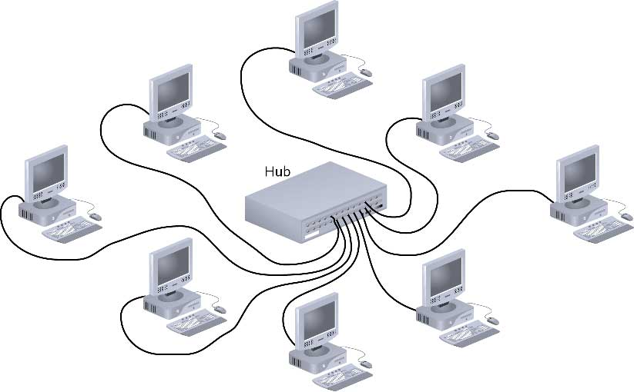
Star
PGDICT4D, 11 Batch

Slide 25
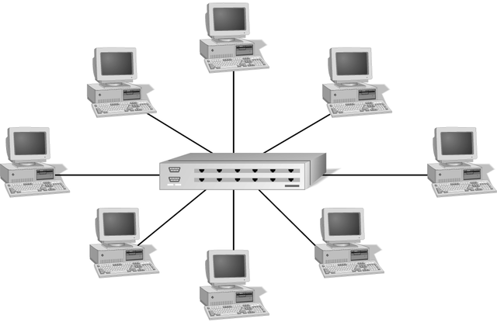
Simple Physical Topologies
Star topology
  Every node on the network is connected through a central device
PGDICT4D, 11 Batch

Slide 26
Star (continued)
Any single cable connects only two devices
  Cabling problems affect two nodes at most
Requires more cabling than ring or bus networks
  More fault-tolerant
Easily moved, isolated, or interconnected with other networks
  Scalable
Supports max of 1024 addressable nodes on logical network
PGDICT4D, 11 Batch

Slide 27
Advantages of Star Topology
Good option for modern networks
Low startup costs
Easy to manage
Offers opportunities for expansion
Most popular topology in use; wide variety of equipment available
PGDICT4D, 11 Batch

Slide 28
Disadvantages of
Star Topology
Hub is a single point of failure
Requires more cable than the bus
PGDICT4D, 11 Batch

Slide 29
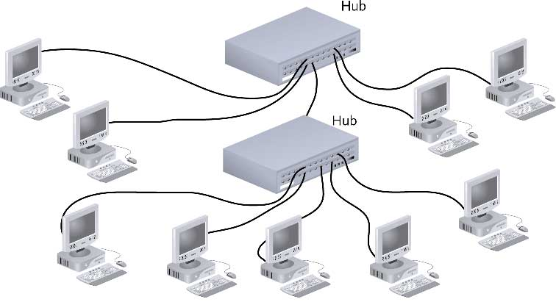
Star-Wired Bus
PGDICT4D, 11 Batch

Slide 30
Backbone Networks:
Serial Backbone
Distributed Backbone
Collapsed Backbone
Parallel Backbone
PGDICT4D, 11 Batch

Slide 31
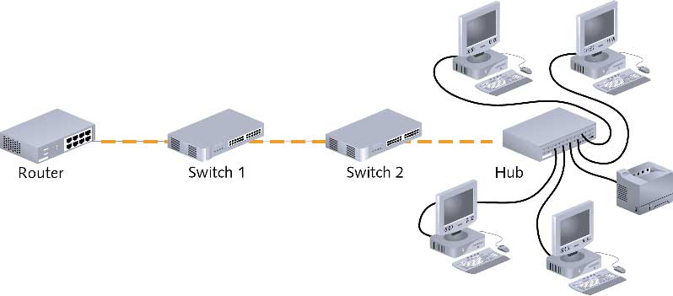
Backbone Networks: Serial Backbone (continued)
PGDICT4D, 11 Batch

Slide 32
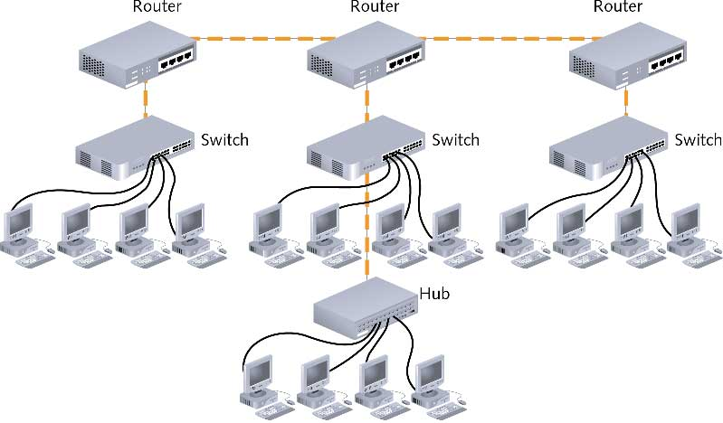
Distributed Backbone
PGDICT4D, 11 Batch

Slide 33
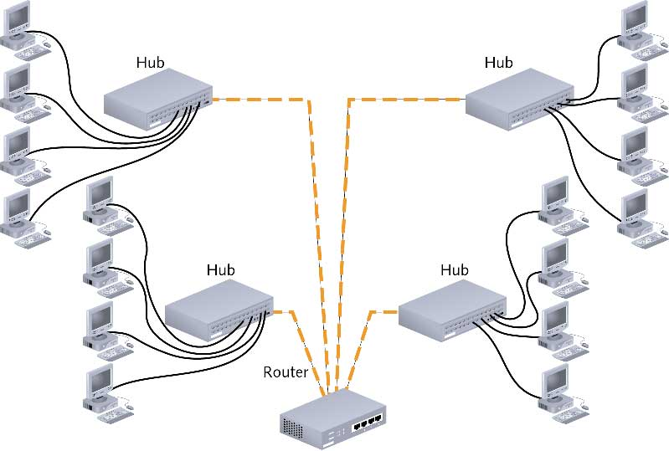
Collapsed Backbone
PGDICT4D, 11 Batch

Slide 34
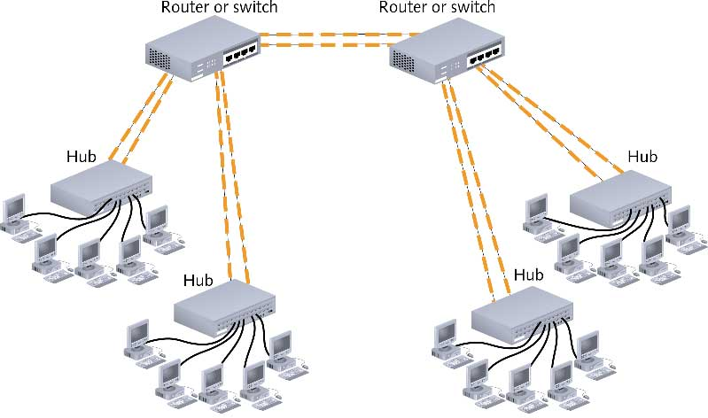
Parallel Backbone
PGDICT4D, 11 Batch

Slide 35

PGDICT4D, 11 Batch

Slide 36
LAN and Wireless
Network | Advantage | Disadvantage
LAN | Reliable High Speed More Secure | More expensive Cable hazard
Wireless (LAN) | Convenience Access Mobility Deployment (Initial setup cost is less) Wireless network is more flexible and adaptable compared to wired network. | Security (encryption is poor) Range (Some meter) Less Speed Some Disruption File-sharing transfer speeds are normally slower with wireless networks than they are with cabled. Unreliability. More open to interference. Increased chance of jamming.
PGDICT4D, 11 Batch

Slide 37

PGDICT4D, 11 Batch

